Slide 1



School of Computing and Information Technology, Eastern International University (EIU) - Vietnam

Slide 2
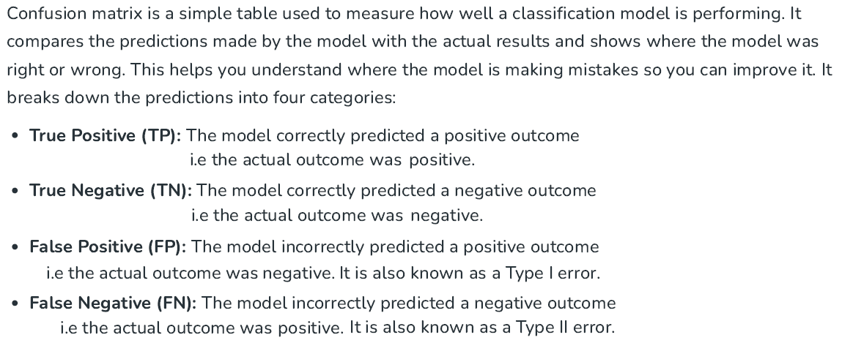
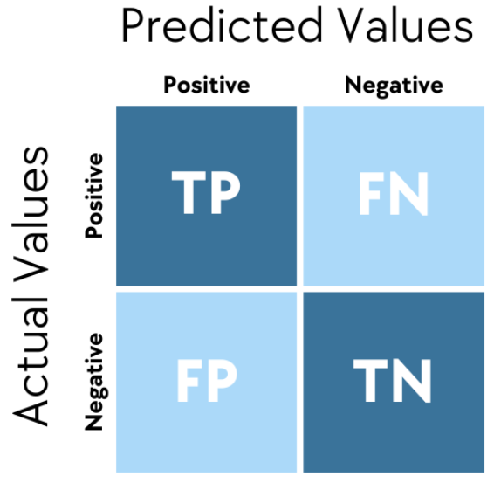
School of Computing and Information Technology, Eastern International University (EIU) - Vietnam

Slide 3
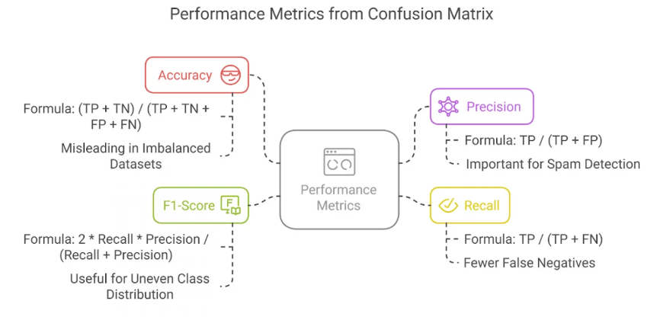
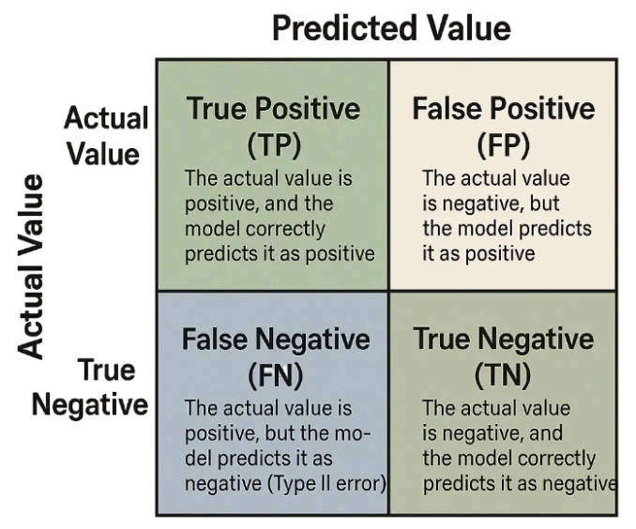
School of Computing and Information Technology, Eastern International University (EIU) - Vietnam

Slide 4




School of Computing and Information Technology, Eastern International University (EIU) - Vietnam

Slide 5







Slide 6





School of Computing and Information Technology, Eastern International University (EIU) - Vietnam

Slide 7
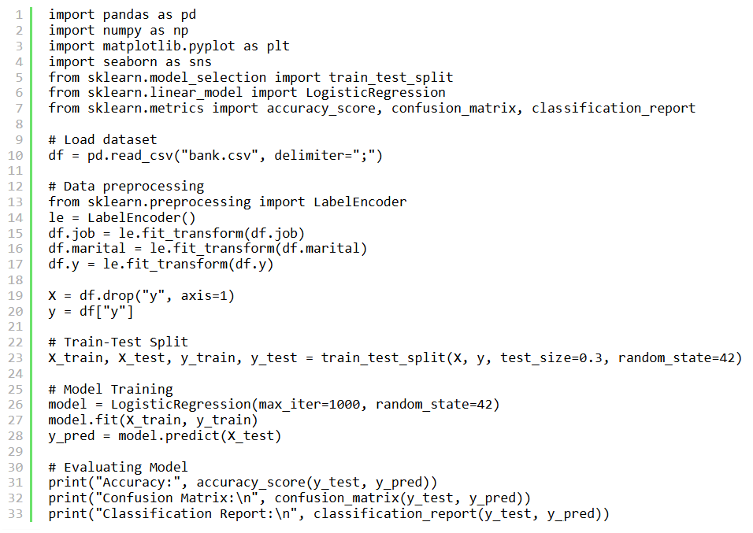
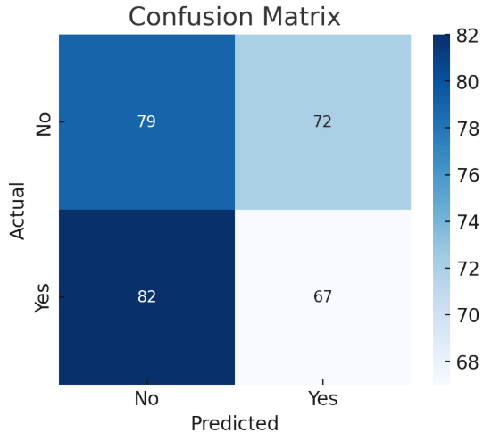
https://www.mygreatlearning.com/blog/confusion-matrix-an-overview-with-python-and-r/

Slide 8

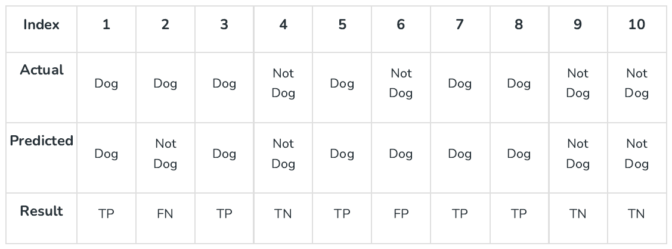
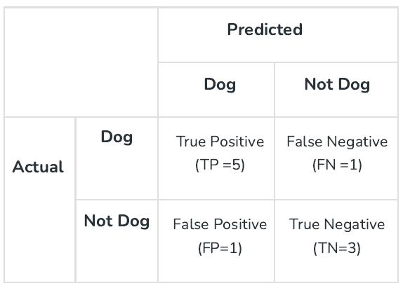

Slide 9


School of Computing and Information Technology, Eastern International University (EIU) - Vietnam

Slide 10


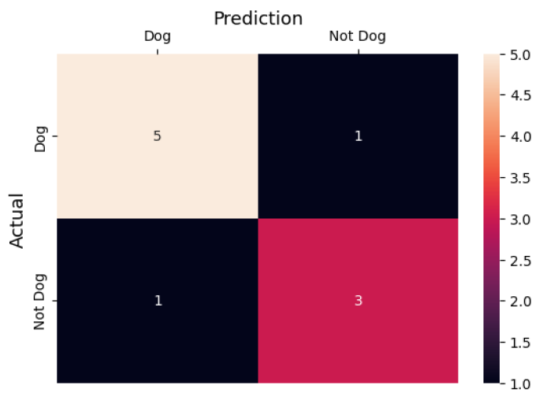
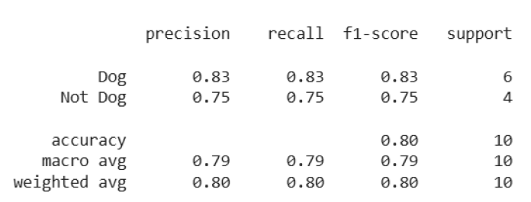


Slide 11

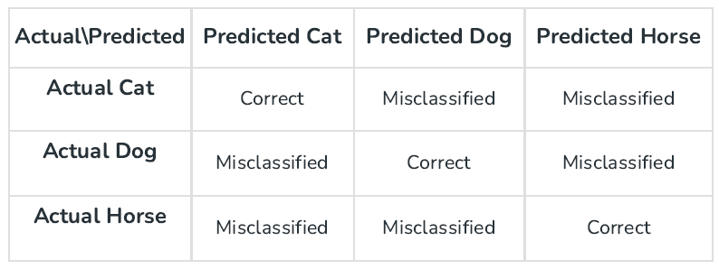

Slide 12

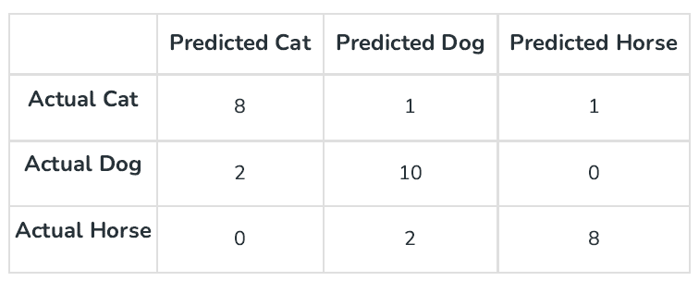


Slide 13


Slide 14
